Slide 1
Automatic Data Processing at the ESRF
Max Nanao

Slide 2
Automatic Processing – why?
+Rapid feedback to user on data quality
+Enables “value added” services
+MR phasing
+Ligand fitting
+Automatic SAD
+QA for us

Slide 3
Automatic processing at ESRF, History
2009 GrenADES (XDS wrapper) Coding and MXCuBE integration
2010 First version available –”fastproc” and “parallelproc”
2010 Automatic SAD incorporated
2012-13 EDNA-ification (Thomas Boeglin)
2015 XDSApp fallback added to GrenADES (Max)
2016 autoPROC added (Olof)
2016 DIALS added (via XIA2 and GrenADES) (Olof, Max)
2016 XDSApp added (Olof)

Slide 4
Automatic processing organisation
MXCuBE
BES
EDNAProc
autoPROC
GrenADES launcher
GrenADES fastproc
XDSAPP
OAR
GrenADES Parallelproc
GrenADES DIALS
XIA2 DIALS
OAR
OAR=Queuing system
BES=Beamline Expert System

Slide 5
Compute Resources
Current configuration:
OAR queuing/scheduling *with a separate scheduler*
29 hosts
2-6 Gb RAM
3-3.3 Ghz AMD
564 “cores”
GPFS
Mean run time : 322.4 s Median run time: 160.0 s
~15k processings/month across all packages

Slide 6
Post processing tasks
Processed data
Summary Display on beamline
Automatic SAD
Molecular replacement from user model
Ligand fitting from user SMILES
Molecular replacement from unit cell (Nearest Cell)
DIMPLE

Slide 7
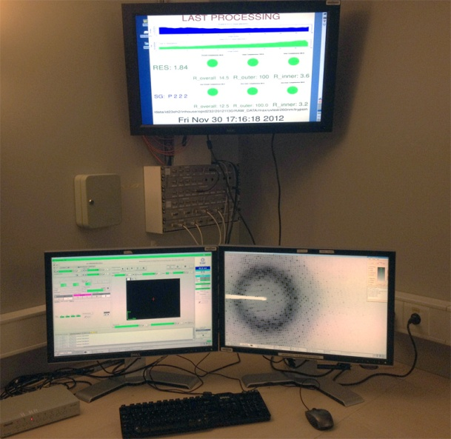
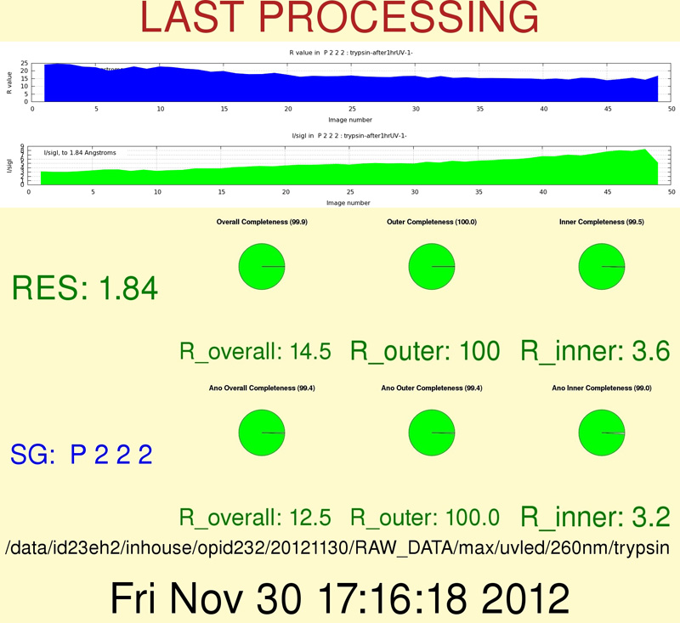
Post processing tasks
Processed data
Summary Display on beamline
Automatic SAD
Molecular replacement from user model
Molecular replacement from unit cell (Nearest Cell)
DIMPLE

Slide 8
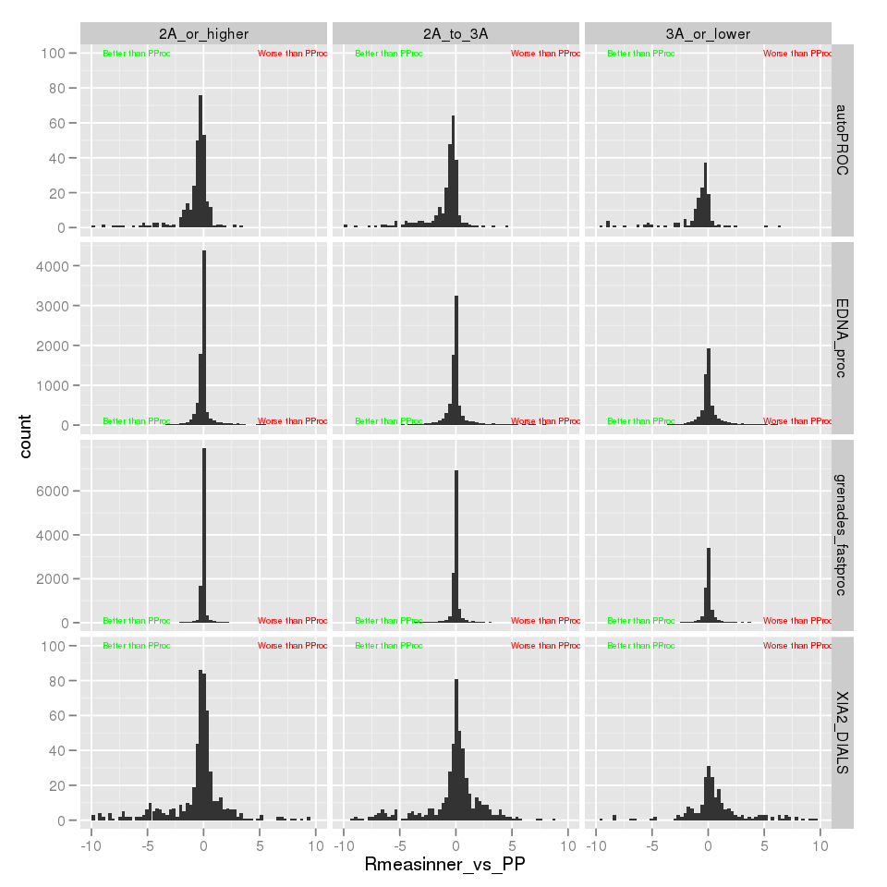
Why so many pipelines?
While in general they perform similarly, no packages appear to consistently do better than others
N.B. “normalized data”: +Statistics calculated with phenix.merging_statistics
+Same resolution limits
+Same Bravais lattice
+Compare to Grenades

Slide 9
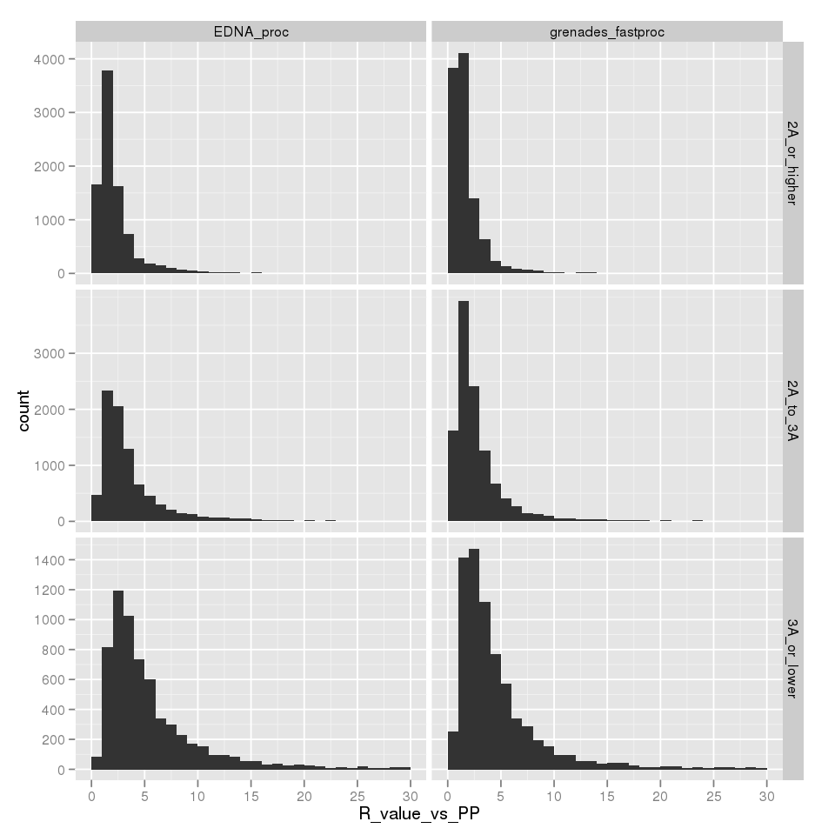
Why so many pipelines
R_{iso} calculated for the same dataset, same XDS, different wrapper
Program | Mean vs Grenades Parallel (%) | Median vs Grenades Parallel (%)
EDNAproc (n=24k) | 5.0 | 2.5
GrenADES fastproc (n=30k) | 4.3 | 1.9

Slide 10
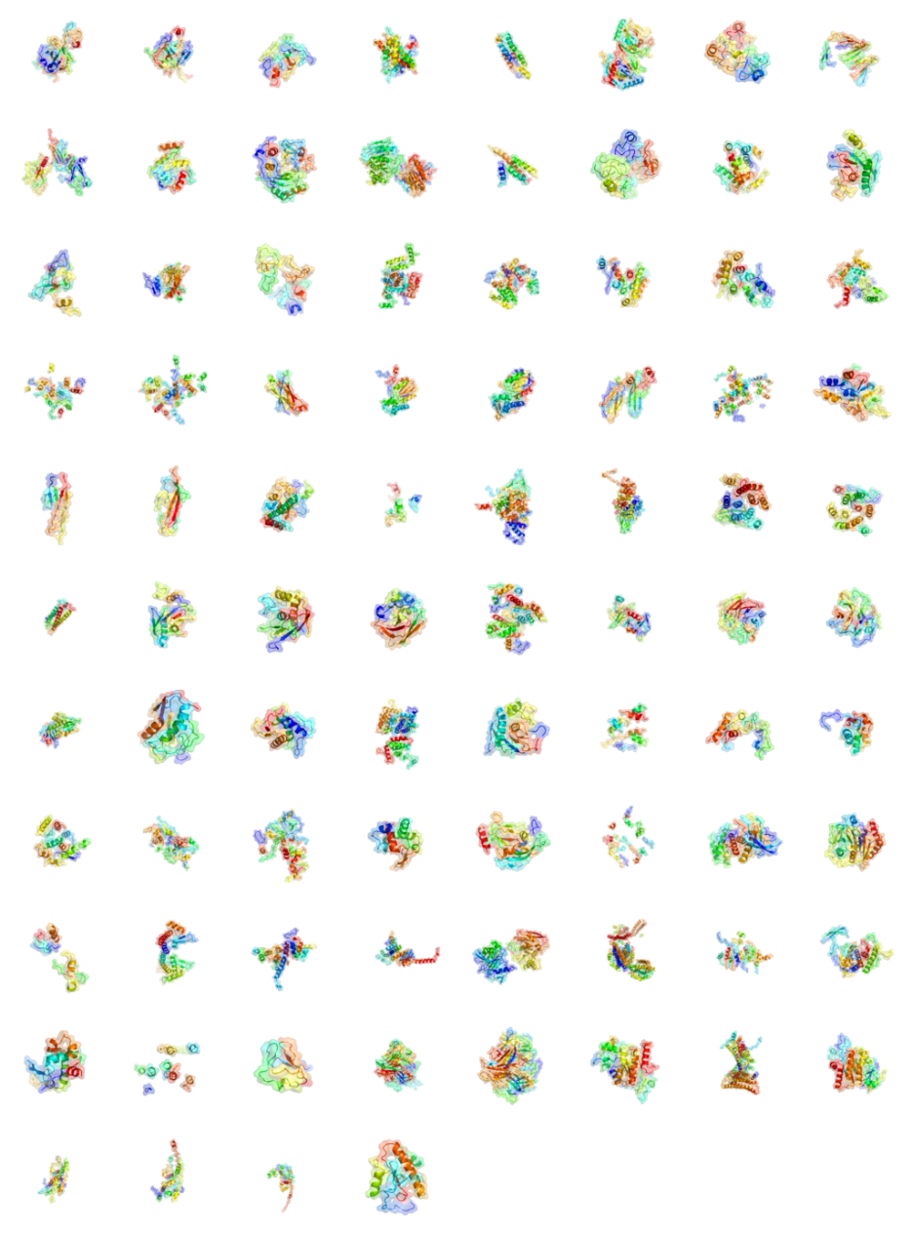
Recent work
Currently
Multiple space groups
Multiple solvent contents
Both hands
→ Many results, ~40 solved⃰ per month May, June July 2016
Notification by
Local Contact email notification
Inspecting the data collection directory tree
→ Integrate SAD results into web interface (Olof, Alejandro, Max)
⃰ Partial CC >25, Avg fragment size >10
datasets, not projects

Slide 11
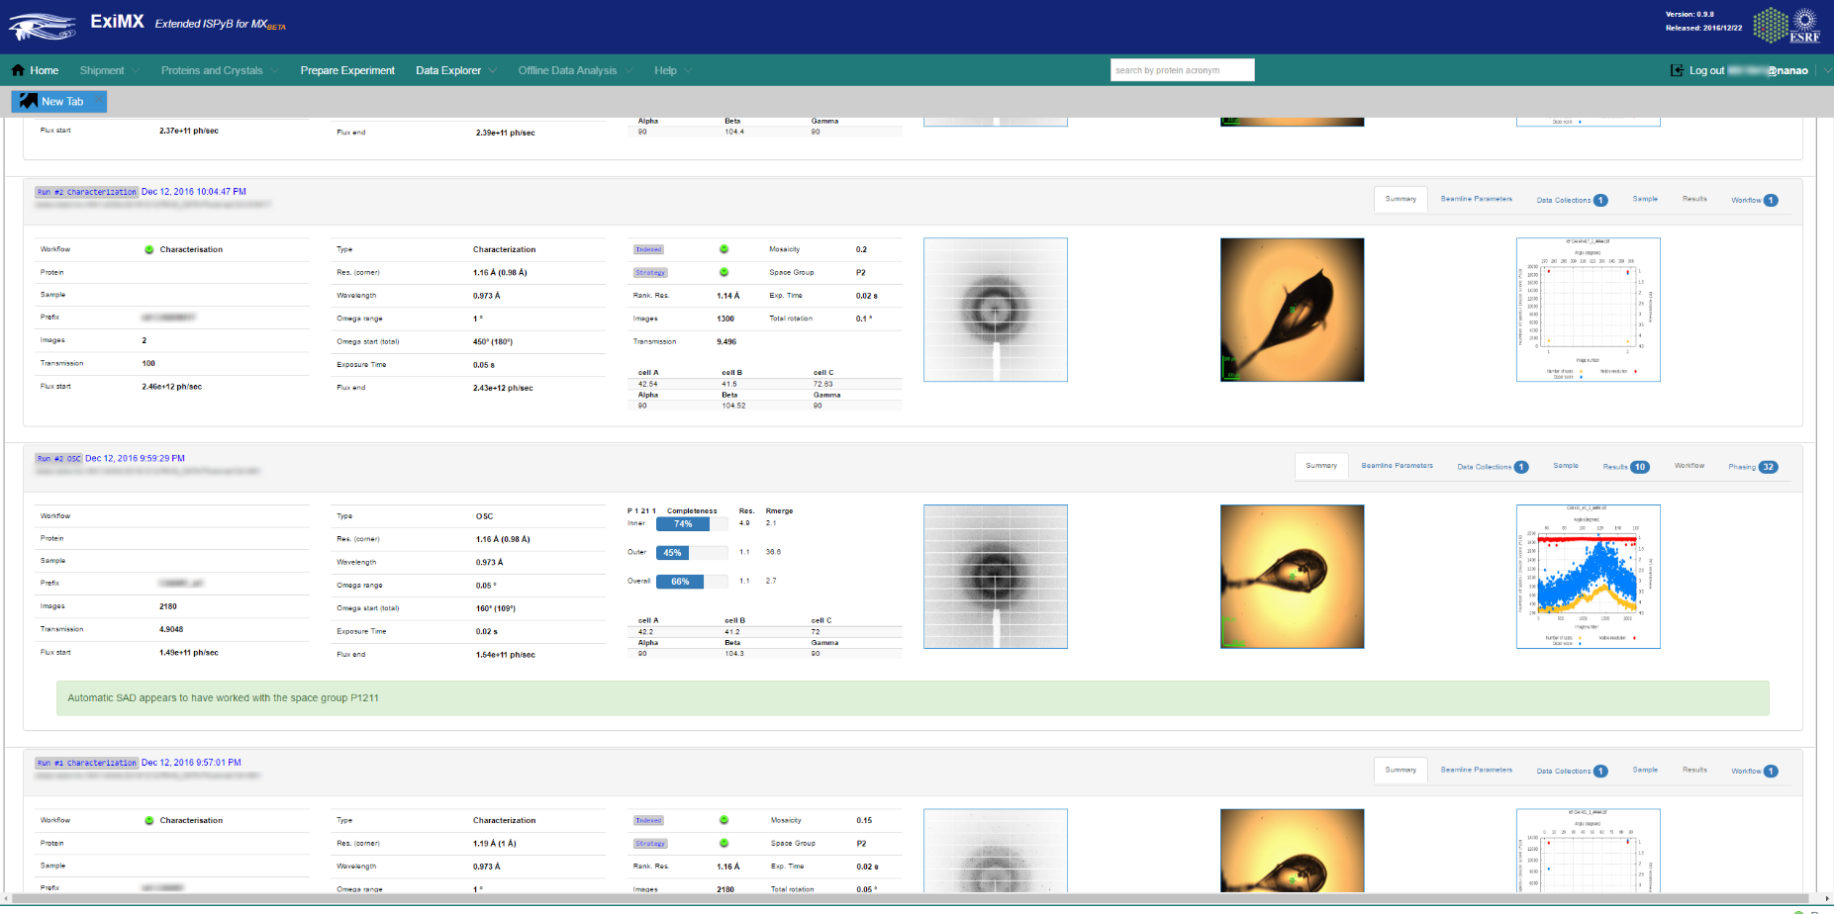
Notification that phasing was successful

Slide 12
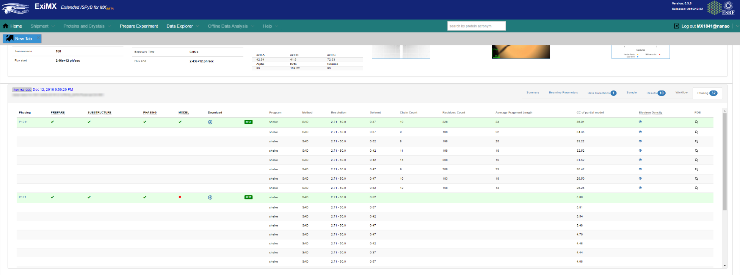
Complete view of all phasing trials
PNG snapshot of PDB
Interactive density viewer (UglyMol)

Slide 13
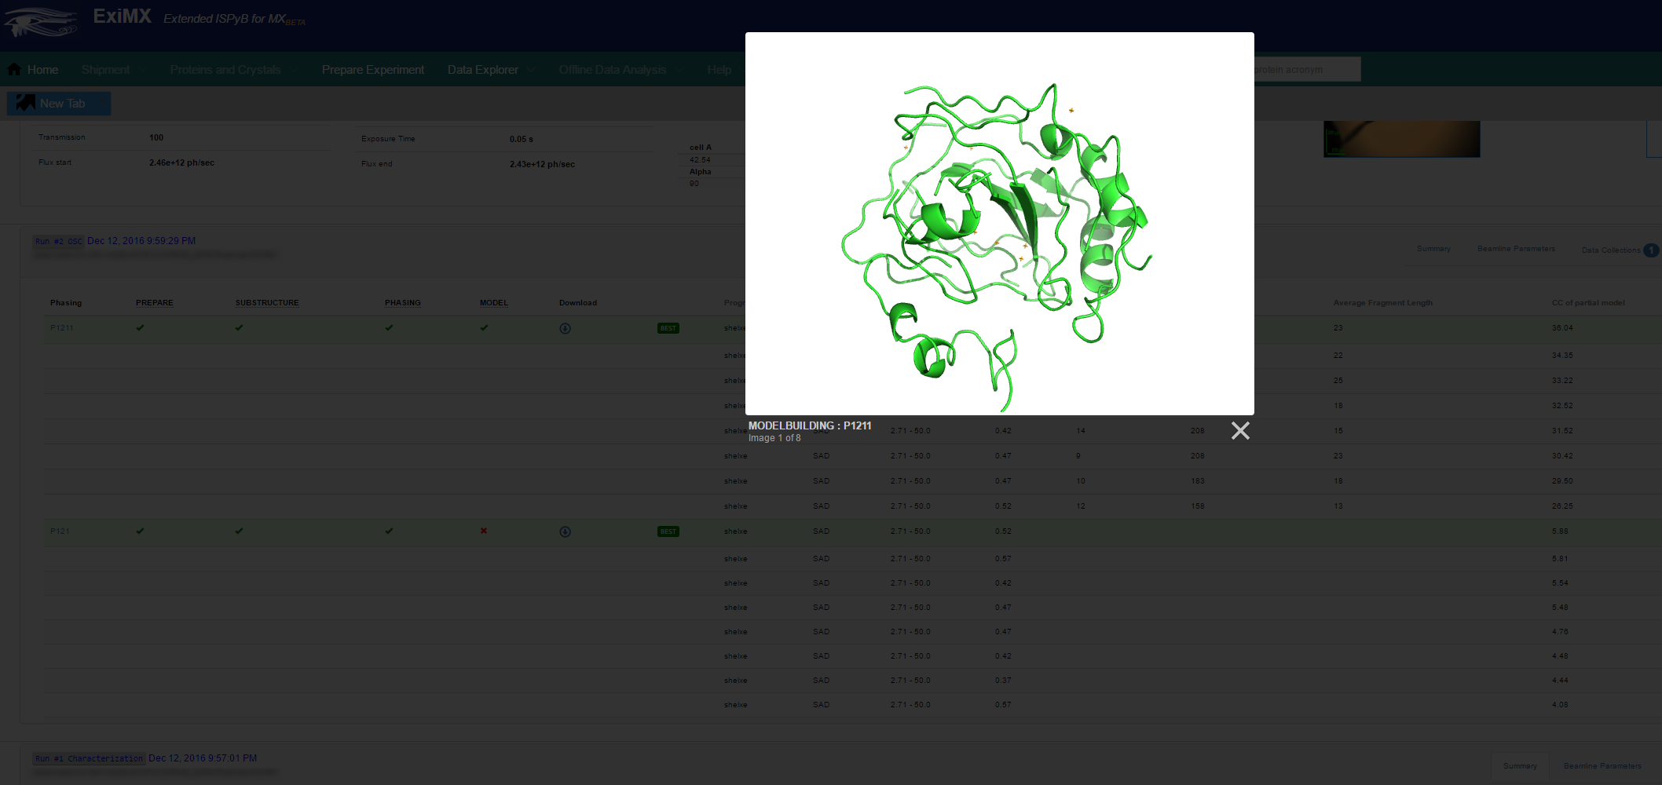
PNG Cartoon of SHELXE model

Slide 14
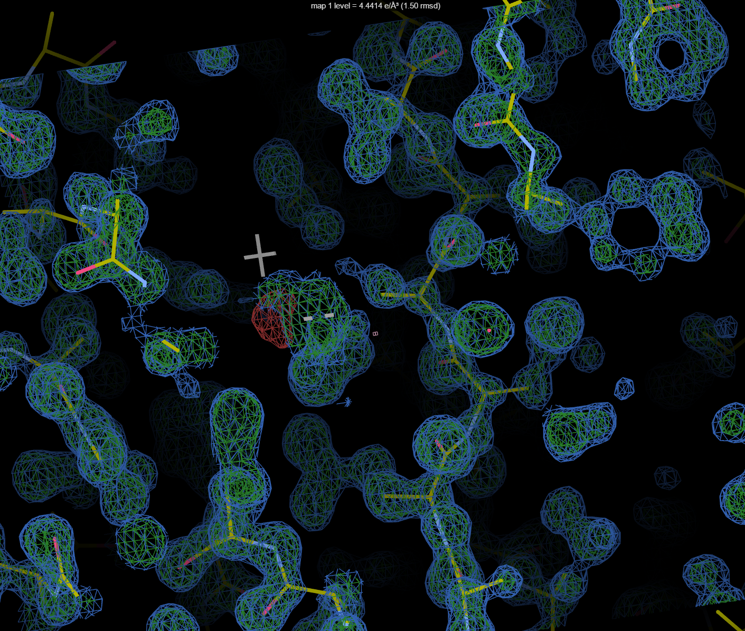
Interactive electron density

Slide 15
To DO
+Molecular Replacement results into database and in EXI
+Coordination with Global Phasing for AutoSHARP, PIPEDREAM?
+More information from user (MXCubE, EXI) on sample – sequence, anom scatterer
+Automatic merging of SSX data
+HCA
+Genetic Algorithm
+User chooses which processing pipelines via MXCuBE?

Slide 16
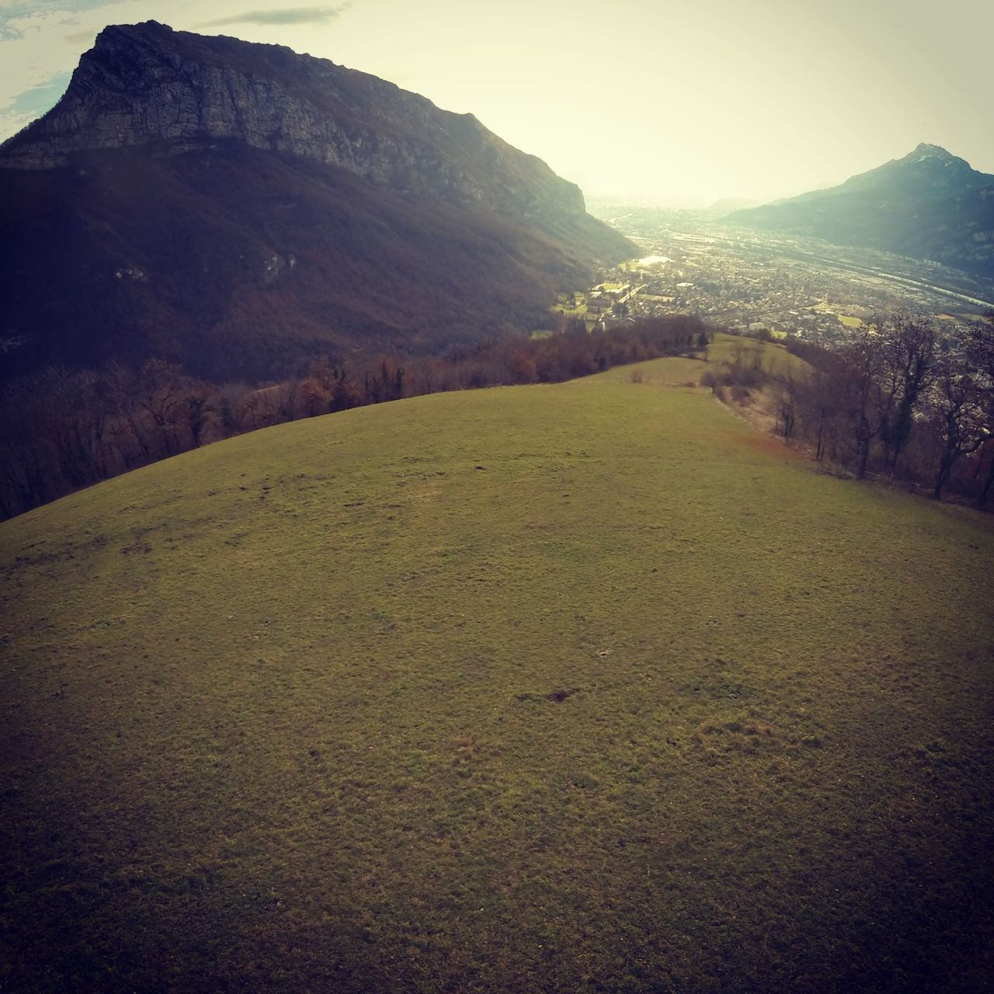
People
Olof Svensson
Alejandro de Maria
Daniele de Sanctis
Matias Guijarro
Thomas Boeglin
Stephanie Monaco
Antonia Beteva
Solange Delageniere
Darren Spruce
Marjolaine Bodin
Matthew Bowler
Sean McSweeney
Elspeth Gordon
Gordon Leonard
Andrew McCarthy

Slide 17
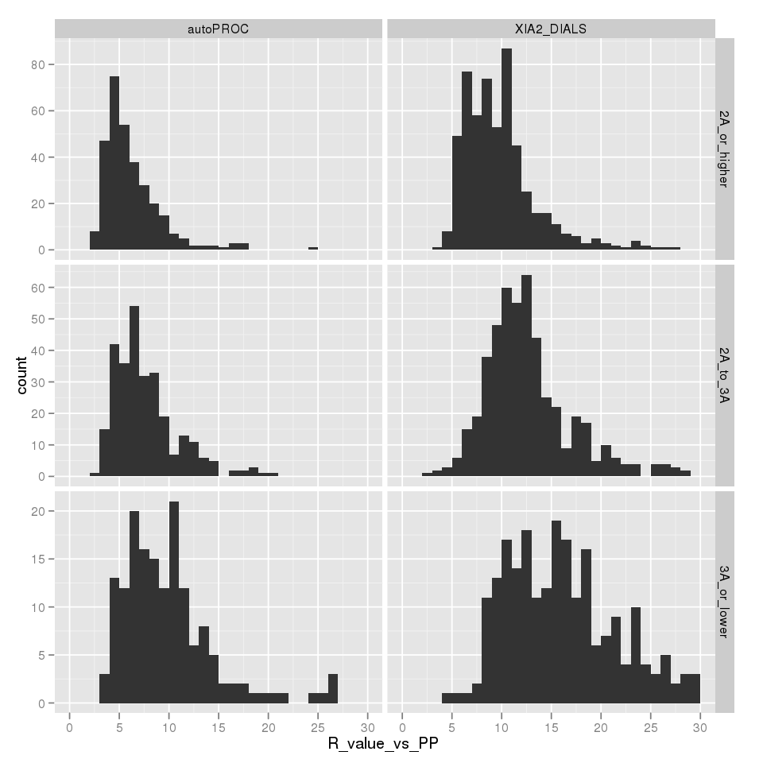
Program | Mean vs Grenades Parallel (%) | Median vs Grenades Parallel (%)
EDNAproc (n=24k) | 5.0 | 2.5
GrenADES fastproc (n=30k) | 4.3 | 1.9
XIA2 DIALS (n=1319) | 13.5 | 11.2
autoPROC (n=776) | 9.5 | 6.8

